Slide 1
Calculating theoretical probabilities from two-way tables (two events)
Probability: theoretical probabilities

Slide 2
How our teaching resources are designed for the classroom

Slide 3
I can calculate and use theoretical probabilities for combined events using two-way tables (2 events).

Slide 4
A theoretical probability is a probability based on counting the number of desired outcomes from a sample space where all individual outcomes are equally likely.

Slide 5

Calculating theoretical probabilities from two-way tables (two events)
Theoretical probabilities
Probabilities for combined events

Slide 6
Theoretical probabilities
A deck of cards contains the numbers 1 to 10.
The cards could be sorted into odds and evens using a table.
1
2
3
4
5
6
7
8
9
10
odd | even
1
3
5
2
4
6
7
9
8
10

Slide 7
Theoretical probabilities
The cards could also be sorted into square numbers and not square numbers using a table.
1
2
3
4
5
6
7
8
9
10
odd | even
square | not square
1
3
5
2
4
6
1
4
2
3
5
6
7
9
8
10
9
7
8
10

Slide 8
Theoretical probabilities
The two tables can be combined.
1
2
3
4
5
6
7
8
9
10
odd | even
square | not square
1
3
5
2
4
6
1
4
2
3
5
6
7
9
8
10
9
7
8
10

Slide 9
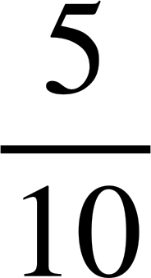
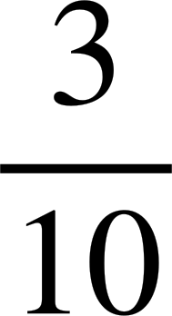
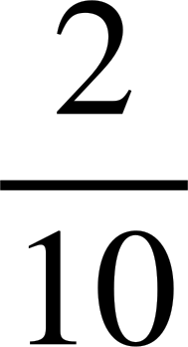
Theoretical probabilities
The two tables can be combined.
1
2
3
4
5
6
7
8
9
10
A card is chosen at random from the deck.
square
not square
P(odd) =
odd
1
9
3
5
7
P(square) =
even
4
2
6
8
10
P(odd and square) =

Slide 10









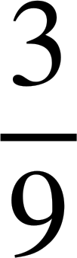
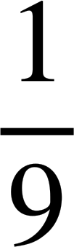
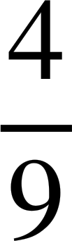
Theoretical probabilities
These drinks have been sorted into the outcome table according to whether they have a handle or a straw.
A
B
C
D
E
F
G
H
I
handle
no handle
A drink is chosen at random.
B
F
D
E
P(no handle and a straw) =
straw
C
H
I
P(handle and no straw) =
no straw
A
G
P(handle and a straw) =

Slide 11

Theoretical probabilities
The spinner is spun once.
What is the probability that it lands on a number that is odd and a factor of 10?
factor of 10
not a factor of 10
5
1
even
2
4
4
2
3
odd
1
3
5
P(odd and a factor of 10) =

Slide 12
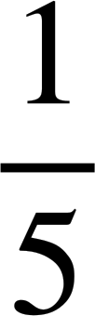
Theoretical probabilities
The spinner is spun once.
What is the probability that it lands on a number that is even and not a factor of 10?
factor of 10
not a factor of 10
5
1
even
2
4
4
2
3
odd
1
3
5
P(even and not a factor of 10) =

Slide 13
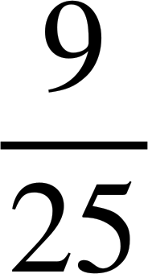
Theoretical probabilities
A game is being played where players spin the spinner twice and find the sum of their numbers.
The outcome table shows the possible totals.
5
1
4
2
3
spin 1
A = {even}
B = {more than 5}
1
2
3
4
5
P(A and B) = {even and more than 5}
1
2
3
4
5
6
2
3
4
5
6
7
=
spin 2
3
4
5
6
7
8
4
5
6
7
8
9
5
6
7
8
9
10

Slide 14
Theoretical probabilities
We can use this outcome table to create a two-way table for the two events A = {even} and B = {more than 5}.
5
1
4
2
By putting the frequencies in it, we can find probabilities about events A and B fairly efficiently.
3
spin 1
1
2
3
4
5
B
not B
total
1
2
3
4
5
6
2
3
4
5
6
7
A
9
4
13
spin 2
3
4
5
6
7
8
not A
6
6
12
4
5
6
7
8
9
5
6
7
8
9
10
total
15
10
25

Slide 15
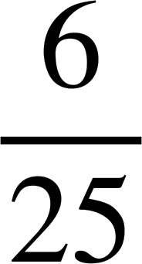
Theoretical probabilities
A game is being played where players spin the spinner twice and find the sum of their numbers.
5
1
4
2
A = {even}
B = {more than 5}
3
B
not B
total
What is the probability that the sum is not even and more than 5?
A
9
4
13
not A
6
6
12
total
15
10
25
What is the probability that the sum is not even and not more than 5?

Slide 16
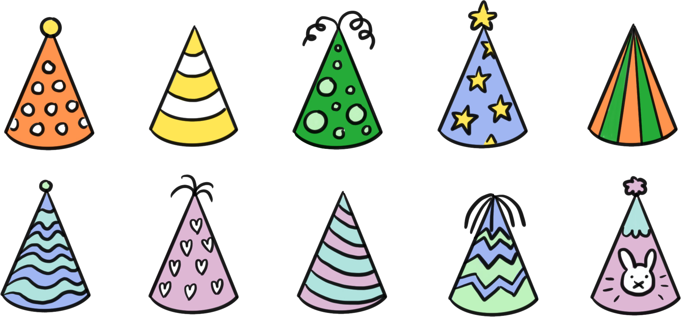
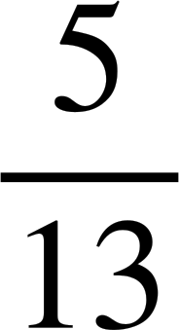
Theoretical probabilities
Some party hats are sorted into an outcome table based on two events, whether they are striped and whether they have a topper.
not striped
If a party hat is chosen at random what is the probability that it is not striped and has a topper?
striped
total
topper
4
5
9
no topper
2
2
4
total
6
7
13

Slide 17
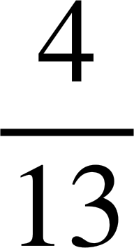
Theoretical probabilities
Some party hats are sorted into an outcome table based on two events, whether they are striped and whether they have a topper.
not striped
If a party hat is chosen at random what is the probability that it is striped and has a topper?
striped
total
topper
4
5
9
no topper
2
2
4
total
6
7
13

Slide 18
Theoretical probabilities
1) This spinner is going to be spun once.
a) Fill in the outcome table for the two events: less than 12 and prime.
4
5
2
7
20
8
16
10
13
11
less than 12
not less than 12
b) Find P(less than 12 and prime)
prime
c) Find P(not prime and not less than 12)
not prime
d) Find P(prime and not less than 12)

Slide 19
Theoretical probabilities
2) This spinner is going to be spun twice and then the product of the two numbers is found.
5
1
a) Complete the outcome table to show the possible products.
4
2
3
spin 1
1
2
3
4
5
b) Find P(square and factor of 36)
1
2
spin 2
3
c) Find P(even and less than 18)
4
5

Slide 20
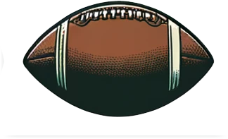
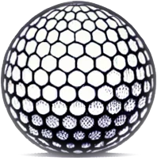
Theoretical probabilities
3) This two-way table shows the frequencies of some sports balls categorised by their shape and whether they have stitching on the surface.
e.g. an american football is not spherical but has stitching, whereas a golf ball is spherical but doesn’t have stitching.
not spherical
A ball is selected at random.
spherical
total
a) Find P(spherical and has stitching)
stitching
4
1
5
no stitching
11
2
13
b) Find P(spherical and does not have stitching)
total
15
3
18

Slide 21
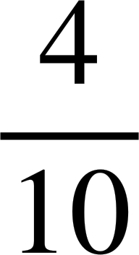
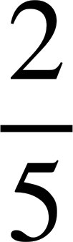
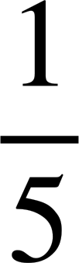

Theoretical probabilities
1) This spinner is going to be spun once.
a) Fill in the outcome table for the two events: less than 12 and prime.
4
5
2
7
20
8
16
10
13
11
less than 12
not less than 12
b) Find P(less than 12 and prime)
2
5
7
13
= = = 0.4 = 40%
prime
11
c) Find P(not prime and not less than 12)
not prime
4
8
16
= = = 0.2 = 20%
10
20
d) Find P(prime and not less than 12)
= = 0.1 = 10%

Slide 22
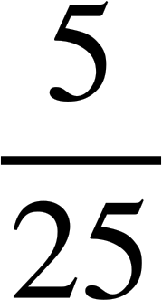
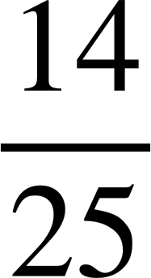
Theoretical probabilities
2) This spinner is going to be spun twice and then the product of the two numbers is found.
5
1
a) Complete the outcome table to show the possible products.
4
2
3
spin 1
1
2
3
4
5
b) Find P(square and factor of 36)
1
1
2
3
4
5
2
4
6
8
10
= = = 0.2 = 20%
2
spin 2
3
3
6
9
12
15
c) Find P(even and less than 18)
4
4
8
12
16
20
5
5
10
15
20
25
= = 0.56 = 56%

Slide 23
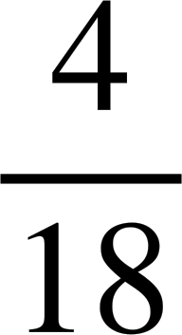
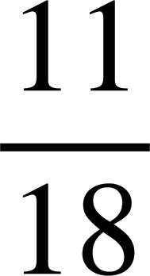
Theoretical probabilities
3) This two-way table shows the frequencies of some sports balls categorised by their shape and whether they have stitching on the surface.
e.g. an american football is not spherical but has stitching, whereas a golf ball is spherical but doesn’t have stitching.
not spherical
A ball is selected at random.
spherical
total
a) Find P(spherical and has stitching)
stitching
4
1
5
no stitching
11
2
13
b) Find P(spherical and does not have stitching)
total
15
3
18

Slide 24
Calculating theoretical probabilities from two-way tables (two events)
Theoretical probabilities
Probabilities for combined events

Slide 25
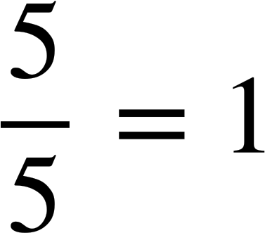
Probabilities for combined events
The spinner is spun once.
not a factor of 10
factor of 10
5
1
even
2
4
4
2
3
5
3
odd
1
What is the probability that the outcome is even or odd?

Slide 26
Probabilities for combined events
The spinner is spun once.
not a factor of 10
factor of 10
5
1
even
2
4
4
2
3
5
3
odd
1
What is the probability that the outcome is even and a factor of 10 or odd and not a factor of 10?

Slide 27
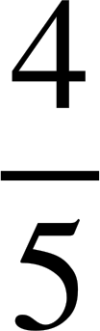
Probabilities for combined events
The spinner is spun once.
not a factor of 10
factor of 10
5
1
even
2
4
4
2
3
5
3
odd
1
What is the probability that the outcome is even and not a factor of 10 or odd?

Slide 28
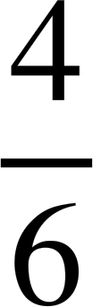
Probabilities for combined events
The spinner is spun once.
not a factor of 8
factor of 8
6
1
5
2
even
2
4
6
win
lose
4
3
odd
1
3
5
What is the probability that the outcome is odd and a factor of 8 or even?

Slide 29
Probabilities for combined events
The spinner is spun once.
not a factor of 8
factor of 8
6
1
5
2
even
2
4
6
win
lose
4
3
odd
1
3
5
What is the probability that the outcome is odd or even and not a factor of 8?

Slide 30
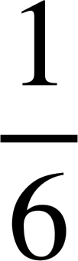
Probabilities for combined events
Lucas and Sam are playing a game with this spinner.
Lucas gets a point if the spinner lands on a factor of 10.
6
1
Sam gets a point if the spinner lands on an even number.
5
2
Lucas doesn’t get a point
Lucas gets a point
win
lose
4
3
Sam gets a point
What is the probability that Lucas and Sam get a point?
2
6
4
Sam doesn’t get a point
5
1
3

Slide 31

Probabilities for combined events
Lucas and Sam are playing a game with this spinner.
Lucas gets a point if the spinner lands on a factor of 10.
6
1
Sam gets a point if the spinner lands on an even number.
5
2
Lucas doesn’t get a point
Lucas gets a point
win
lose
4
3
Sam gets a point
What is the probability that Lucas or Sam get a point?
2
6
4
Sam doesn’t get a point
5
1
3
Lucas could get a point and Sam doesn’t
Sam could get a point and Lucas doesn’t
Lucas and Sam could both get a point

Slide 32

Probabilities for combined events
Which of the following satisfies an outcome being even or a factor of 50?
The outcome is even and not a factor of 50
The outcome is even and is a factor of 50
The outcome is odd and not a factor of 50
The outcome is odd and is a factor of 50

Slide 33
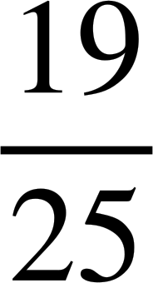
Probabilities for combined events
A game is being played where players spin the spinner twice and find the sum of their numbers.
5
1
4
2
A = {even}
B = {more than 5}
3
B
not B
total
What is the probability that the sum is even or more than 5?
A
9
4
13
not A
6
6
12
total
15
10
25

Slide 34
Probabilities for combined events
A game is being played where players spin the spinner twice and find the sum of their numbers.
5
1
4
2
A = {even}
B = {more than 5}
3
B
not B
total
What is the probability that the sum is even or more than 5?
A
9
4
13
not A
6
6
12
total
15
10
25
What is the probability that the sum is even and not more than 5 or more than 5?

Slide 35
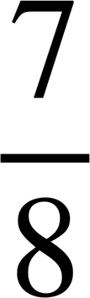
Probabilities for combined events
An 8-sided dice, has the numbers 1 to 8.
What is the probability that when it is rolled it lands on a factor of 8 (F) or an odd number (O)?
F
not F
total
O
1
3
4
not O
3
1
4
total
4
4
8

Slide 36
Probabilities for combined events
1) This outcome table shows the sample space {1, 2, 3, 4, 5, 6, 7, 8, 9}.
not a factor of 18
factor of 18
An outcome is going to be randomly selected.
Find the probability it is:
even
2
6
4 8
a) even and a factor of 18 or odd
odd
1
3
9
5
7
b) odd and a factor of 18 or even
c) a factor of 18 or even and not a factor of 18
d) not a factor of 18 or even

Slide 37
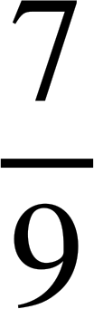
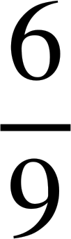
Probabilities for combined events
1) This outcome table shows the sample space {1, 2, 3, 4, 5, 6, 7, 8, 9}.
not a factor of 18
factor of 18
An outcome is going to be randomly selected.
Find the probability it is:
even
2
6
4 8
a) even and a factor of 18 or odd
odd
1
3
9
5
7
b) odd and a factor of 18 or even
c) a factor of 18 or even and not a factor of 18
d) not a factor of 18 or even

Slide 38
Calculating theoretical probabilities from two-way tables (two events)
Outcome tables can be used to find theoretical probabilities of combined events.
In some combinations, an outcome appears in both and therefore is only included once.

Slide 39

© Oak National Academy 2024.
Produced in partnership with Mathematics in Education and Industry.
Licensed on the Open Government Licence v3.0, except where otherwise stated. See Oak terms and conditions.

